Slide 1


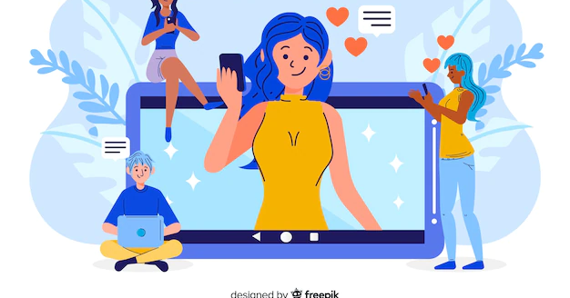
Self, Identity, and Impression Management

Slide 2

What is the Self?
Our Sense of Who We are as Individuals
The Source and Object of Reflexive Behaviour
The Self as both Active and Passive

Slide 3
Mead’s ‘I’ and ‘me’
Both the I and the Me make up the Self
‘Me’ is the Socialized Self
‘I’ is the Impulse

Slide 4

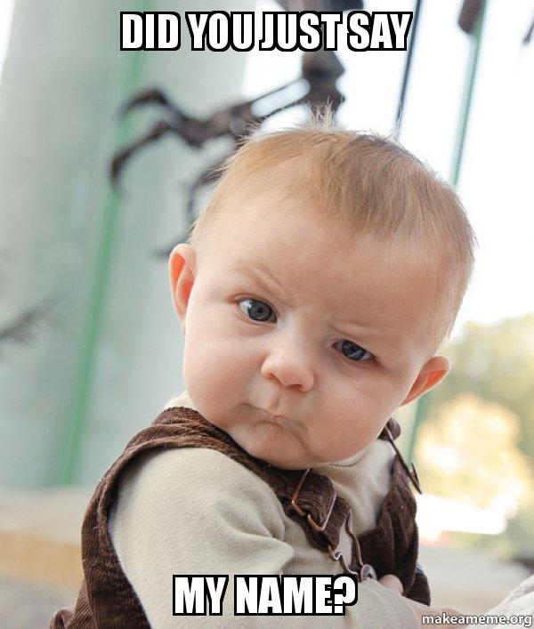
Importance of Language
An important step in acquiring a sense of self is learning one’s name as a child
One of the earliest steps

Slide 5
Role-Taking
‘the process of imaginatively occupying the position of another person and viewing the self and the situation from the person’s perspective’
Another Important Step in the Development of Self

Slide 6

Cooley and the Looking-Glass Self
Self as Social Object
Perception of Self is Based on the Perception of Others’ Perceptions
The Image of Our Self is Acquired Through Social Relationships
‘Significant Others’

Slide 7
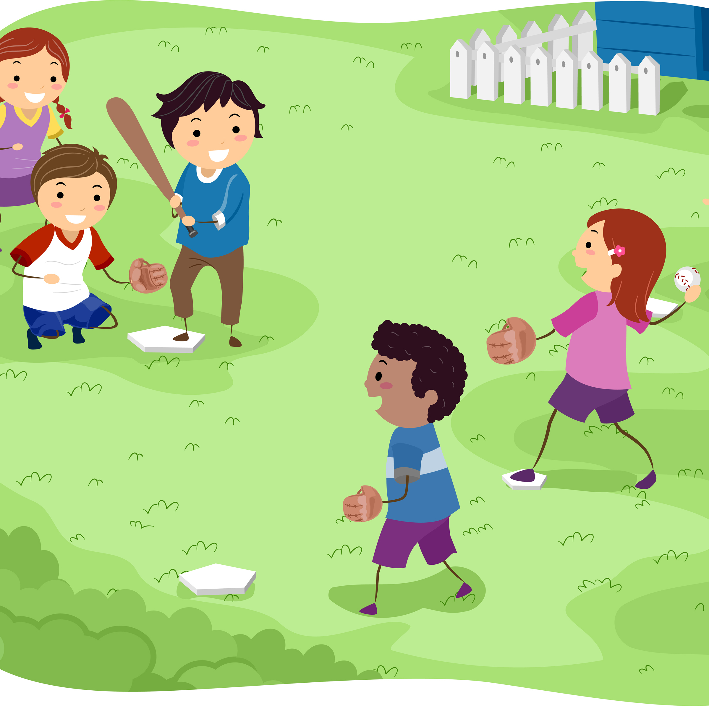
Mead’s Play and Game
2 Stages to the Emergence of Self
Play
Imitating roles they see enacted by adults
Game
More complex; taking on the roles of those around them

Slide 8
The Generalized Other
“a conception of the attitudes and expectations held in common by the members of the organized groups with whom they interact”
When we imagine what the group expects of us, we are taking on the role of the generalized other

Slide 9
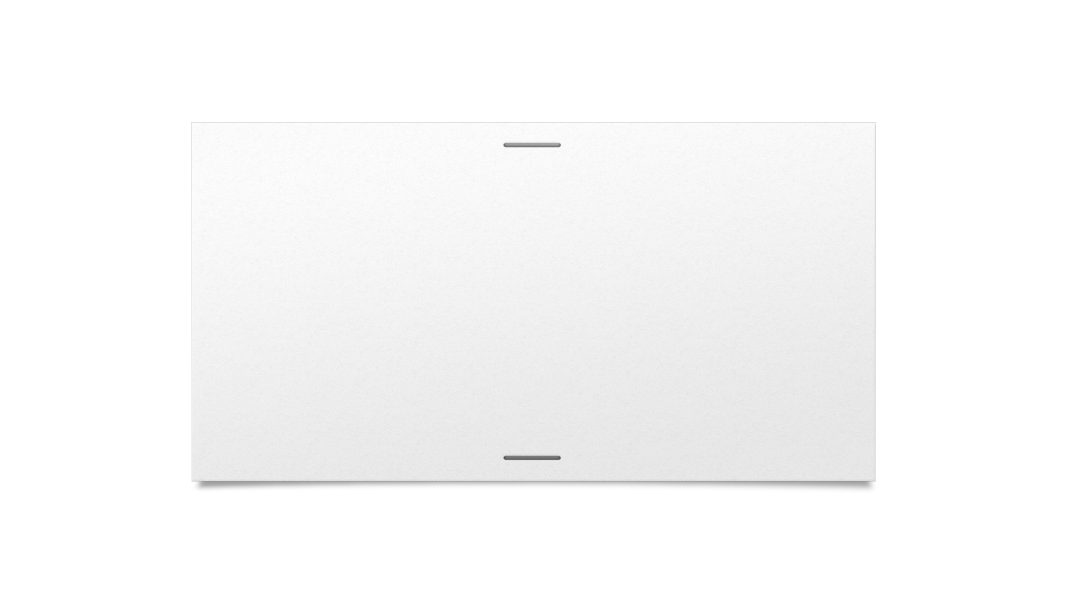


Sense of Self

Slide 10
Self-Perceptions When We Are With Others
Spotlight Effect
“the belief that others are paying more attention to our appearance than they actually are” (Myers et al.)
Illusion of Transparency
“the illusion that our concealed emotions leak out and can be easily read by others” (Myers et al.)

Slide 11
Self and Culture
Individualism vs. Collectivism
Independent Self vs. Interdependent Self

Slide 12
Self-Esteem
Our Sense of Self-Worth
Low Self-Esteem Can Lead To:
Higher levels of anxiety, loneliness, more problems faced in everyday life
High Self-Esteem Can Lead To:
Better performance, more confidence
Possibility of Narcissism

Slide 13
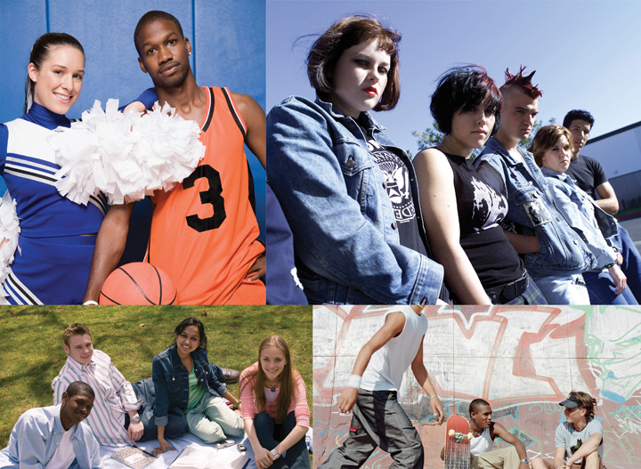
Identities
‘Meanings attached to the self by one’s self and others’
We Possess Multiple Identities
Role Identities
Social Identities

Slide 14
Identity Salience
Which Identity is More Prominent
Hierarchy of Identities
Mom
Doctor
Habs Fan
Whovian

Slide 15
Identity Salience
More Salient Identities will be Enacted with More Frequency
More Salient Identities will be Enacted in More Situations
More Salient Identities are Less Situational
Conform More with Role Expectations of Salient Identities

Slide 16
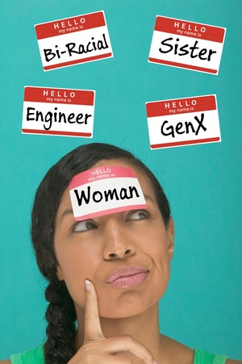
Unified Experience of Self

Slide 17
Self-Presentation
Inherent in All Social Situations
“the processes by which individuals attempt to control the impressions that others form of them in social interactions”
Authentic, Ideal, and Tactical

Slide 18
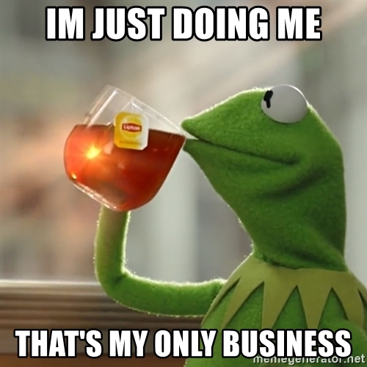
Authentic Self-Presentation

Slide 19
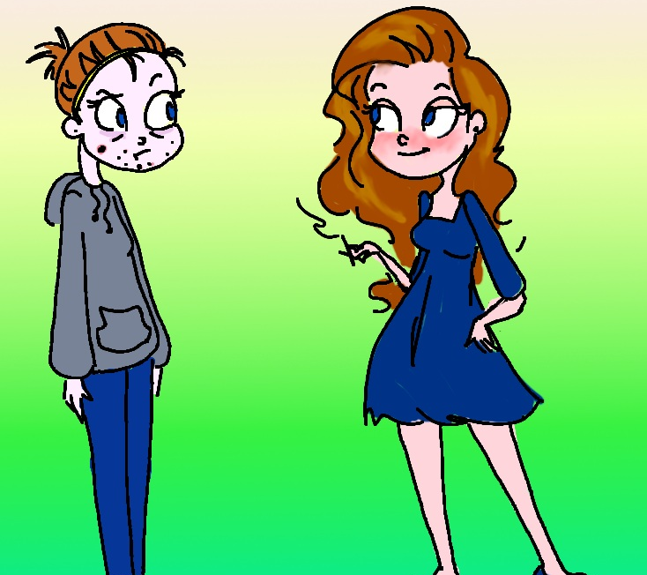
Ideal Self-Presentation

Slide 20
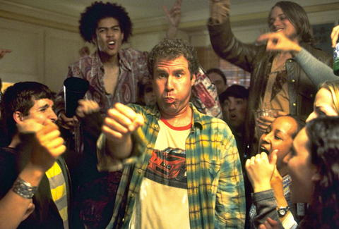

Tactical Self-Presentation

Slide 21
Shared Definitions of a Situation
For Social Interaction to Run Smoothly, We Need:
Shared Understanding of the Situation
Sense of Situated Identity
Shared Sense of Interaction Goals, Appropriate Actions and Behaviours

Slide 22

Frames
“a set of widely understood rules or conventions pertaining to a transient but repetitive situation that indicates which roles should be enacted and which behaviours are proper”

Slide 23

Situated Identity
Our conception of who we are in relation to the people around us

Slide 24
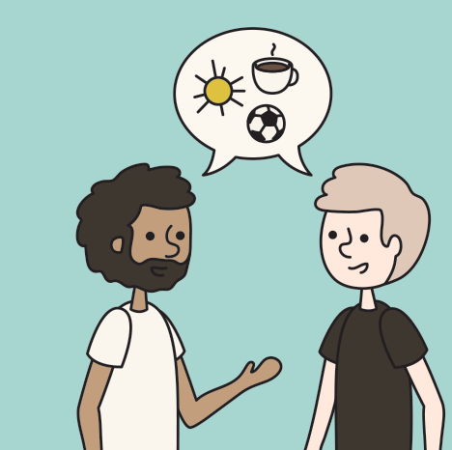
Self-Disclosure
Process of Revealing Feelings/Behaviours to Others
The more comfortable we get, the more we reveal – more authentic self
Reciprocal Process

Slide 25
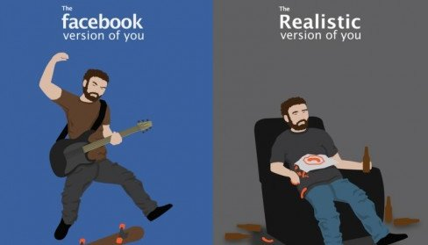
Impression Management

Slide 26
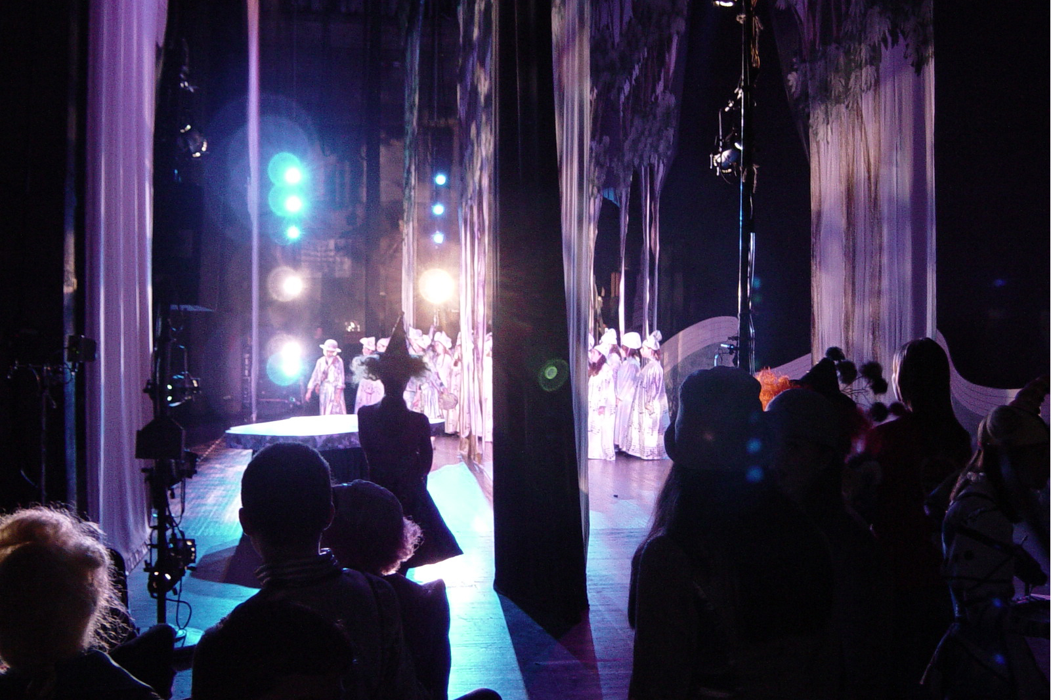
Dramaturgy
Erving Goffman
Putting on a Performance
Front and Back Stage

Slide 27
Tactical Impression Management
Conscious Decision to Control Information in an Interaction to Influence Impressions
Why Do We Do This?
To get people to like us
To get people to respect us
To get people to fear us
To get people to feel sorry for us

Slide 28
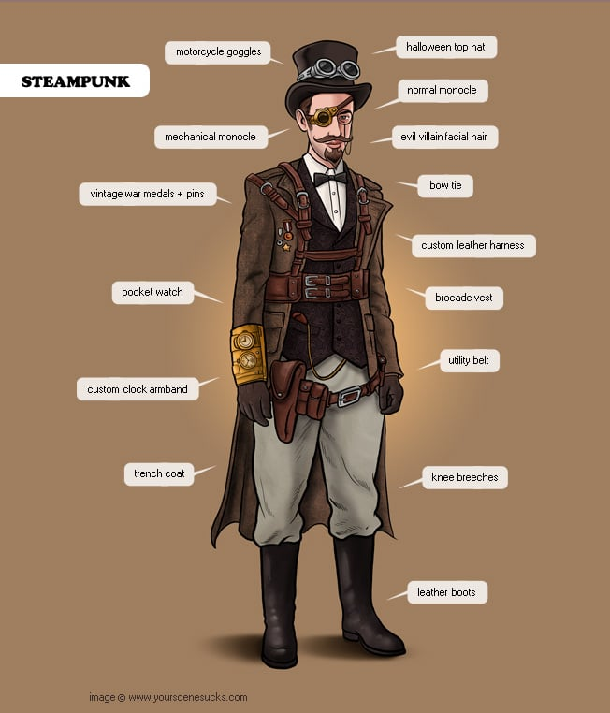
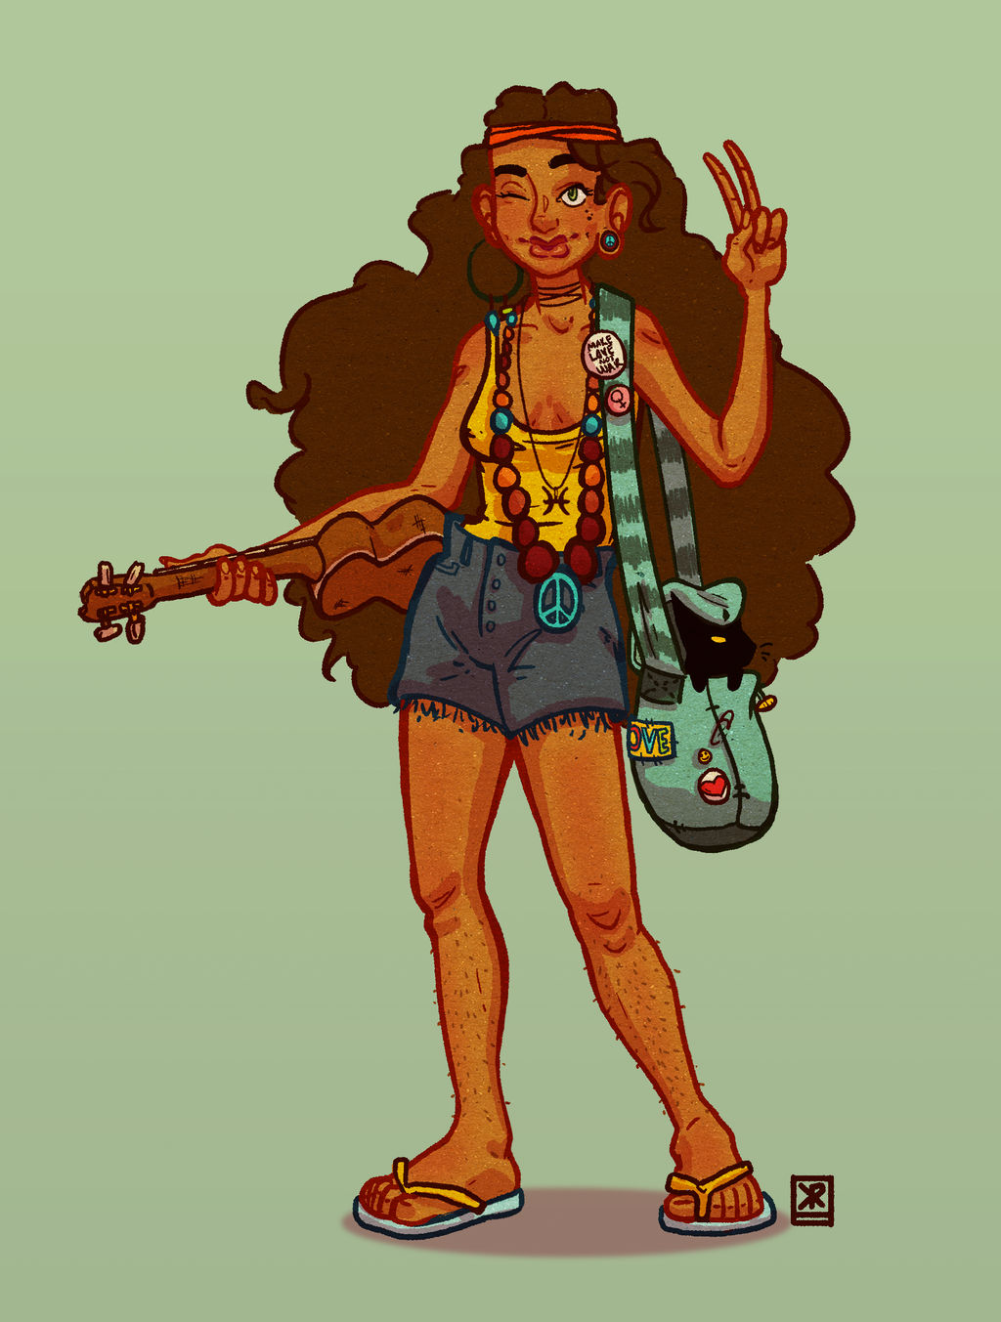
Impression Management Tactics: Physical Appearance and Props

Slide 29
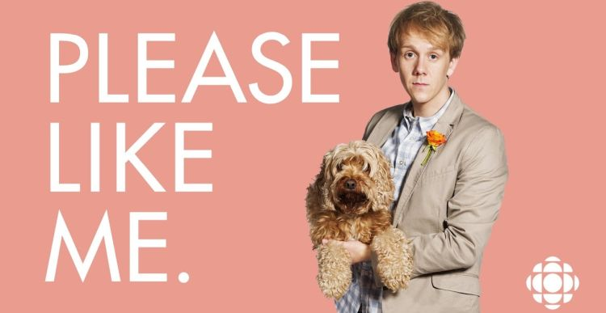
Impression Management Tactics: Ingratiation
The Attempts We Make to Get Someone to Like Us
Can be Done Consciously or Automatically

Slide 30
Ingratiation Strategies
Opinion Conformity
Other Enhancement
Supplication
Selective Self-Presentation

Slide 31
Aligning Actions
Results from an Impression Management ‘Fail’
How We Neutralize the Situation
Disclaimers and Accounts

Slide 32
When Impression Management Fails
Cooling Out
Eased out of the role
Alternative identity options
Close relationships
Identity Degradation
Forced out of role
No adequate alternative identities
Dramatic degradation ceremony

Slide 33
Stigma and Spoiled Identities
Goffman (again)
An attribute, behaviour, reputation, or identity that is socially discrediting in some way
Discredited and Discreditable
A Number of Coping Strategies
Concealment
Remedy the Stigma
Overly Pleasant

Slide 34
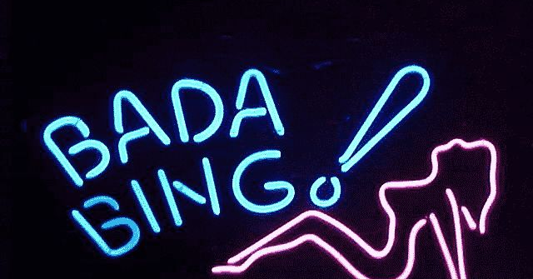
Case Study
“Topless Dancers: Managing Stigma in a Deviant Occupation.” Thompson and Harred (1992)
Ethnography
Division of Social Worlds and Techniques of Neutralization

Slide 35
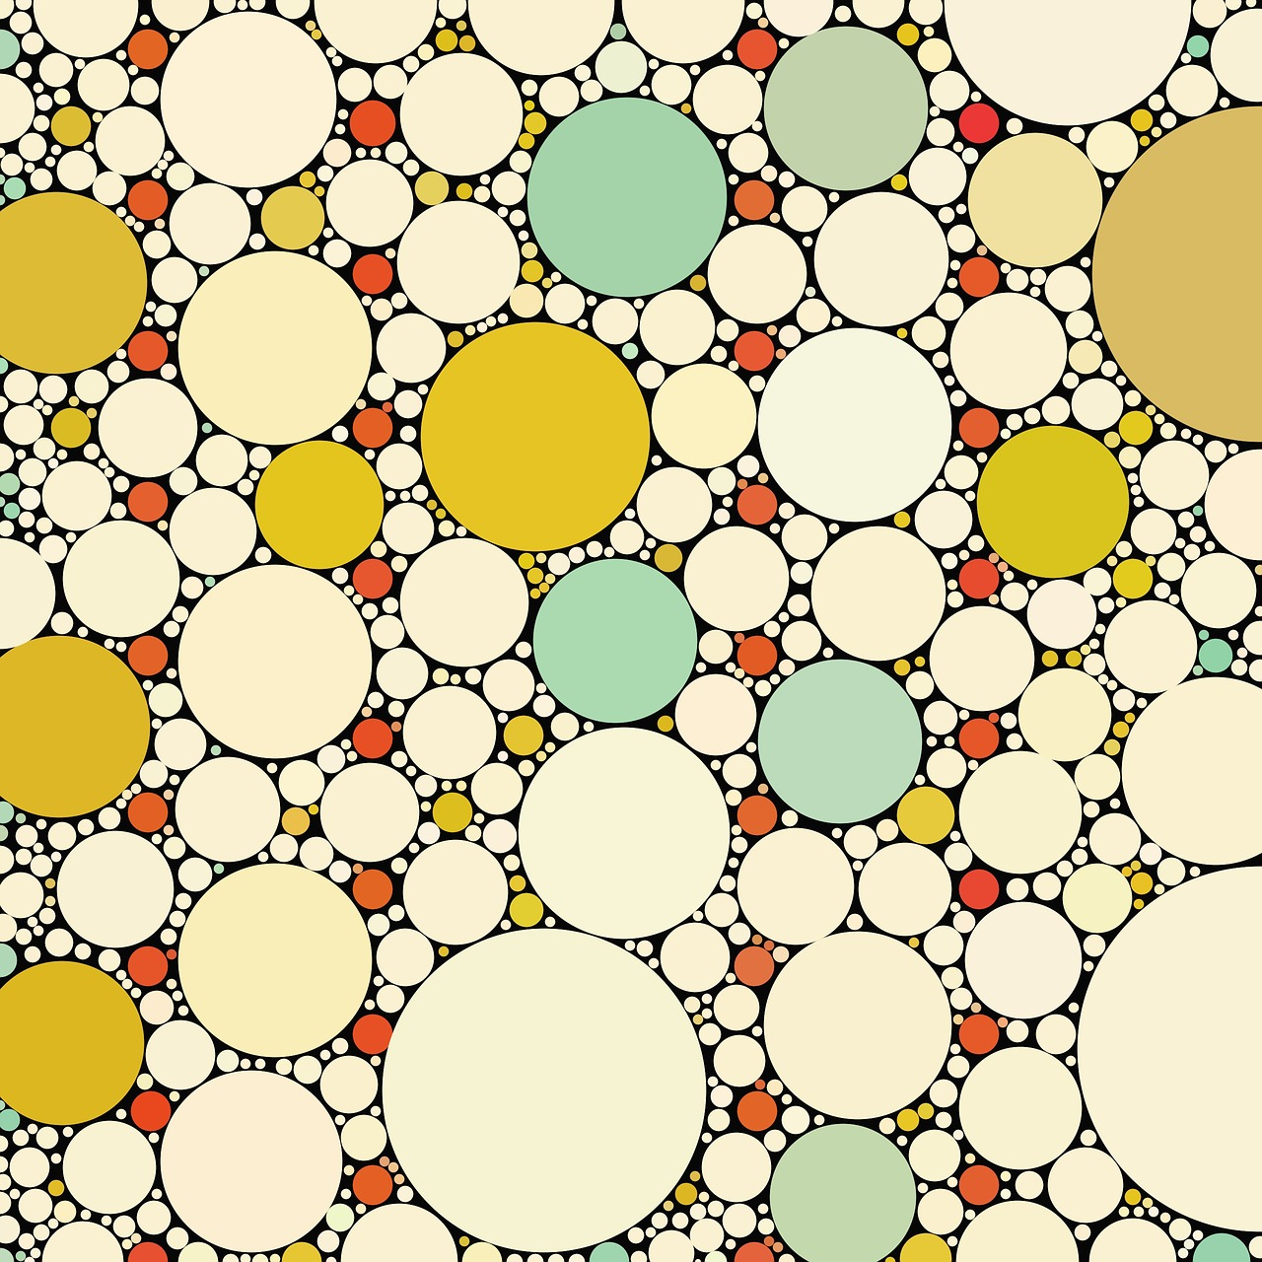

Have a Great Day!

